Slide 1
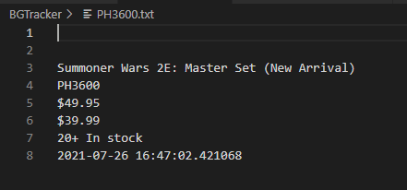
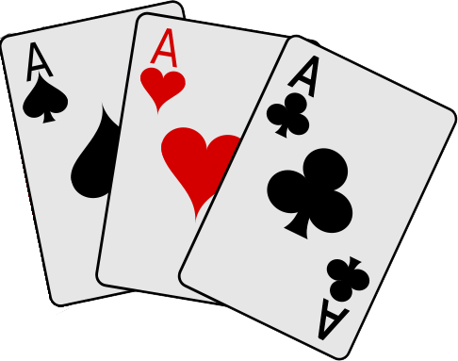
BGTracker
A web scraper to track board game data and changes from MiniatureMarket.com
Designed by Adam Blankenship
https://github.com/ksu-is/BGTracker

